Slide 1

The Walt Disney Company
Kyla | Hareem | Steven | Luke | Goutam

Slide 2
Work Experience with Diversity and Team Performance
Diversity is a double-edged sword:
Having various perspectives increases a team’s ability to solve problems
POV: Call Centre employee engaging in empathy
Too many differing perspectives can create communication problems
POV: Bartender and Bar Runner working in sync
Notes:
Luke

Slide 3



What does a call centre look like?
Notes:
Luke

Slide 4
Learning from empathetic communicators
Men engage in “Report Talk”
Facts
Strictly problem solving
“Women have a higher of relationship building through ‘rapport talk’”
Building relationships
Empathizing with each other
(Mcshane et al., 2021, p. 263)
In a call centre environment, empathy is the key to customer service
Notes:
Luke

Slide 5

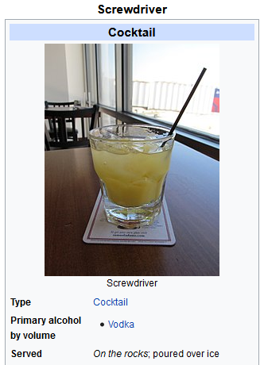
But really, what is a screwdriver?
One word can have different meanings
Context matters
Having common perspectives is key to effective communication
It takes effort to understand each other
Diversity makes it harder
Different backgrounds means different interpretations of context clues
Notes:
Luke

Slide 6

Diversity at a workplace
What does a diverse group of people bring to a workplace?
Variety of Perspectives
People from different cultures have different ways of thinking at a same problem. Embracing perspectives from various cultures, backgrounds, and ethnicities helps us see problems anew, and consider ideas that may go unnoticed.
Increased Creativity
A meta-analysis of 108 studies and more than 10,000 teams indicated that there are creativity gains produced by higher team diversity. Directly correlated with more perspectives on a problem.
Notes:
goutam

Slide 7
Diversity at a workplace
What does a diverse group of people bring to a workplace?
Higher employee engagement
There is direct link between organizations with diverse workforces and better engagement & performance. Employers generate loyalty and benefit from increased engagement.
Better reputation for organization
67% of job seekers said a diverse workforce is important when considering job offers.
Companies with diverse workplace has very less Employee turnover rate.
Increased employee retention by optimization of employee experience.
Notes:
goutam

Slide 8
How Disney Encourages Open Communication
Leaders listen to any feedback given by their employees, with the intention to take proper action
One specific example is Disney’s “leader walks”, where they work with their team members on a frontline shift, to better understand what the day to day operations look like
This is an opportunity for them to personally meet with employees individually in a real-life situation
Notes:
kyla

Slide 9
How Collaborative Teamwork Skills are Nurtured
At Disney, collaboration skills within a team are often developed through constructive conflict
Leaders are always looking for ways to push their teams to use their collaboration skills
Constructive conflict is an effective way of strengthening their teamwork skills, and will help the organization to grow and move forwards
Notes:
kyla

Slide 10
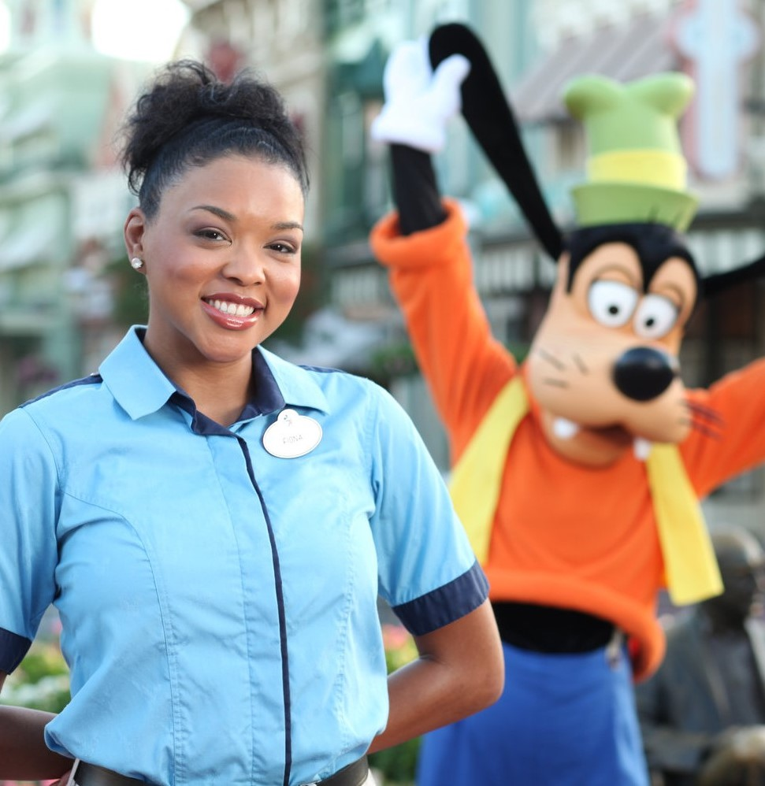
In order for conflict to be constructive and not counterproductive, the work environment must be a safe place for employees
This environment must be properly maintained by those in leadership positions
Team members are encouraged to share their thoughts and express opinions with each other and management
Notes:
kyla

Slide 11
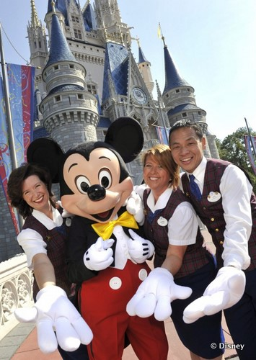
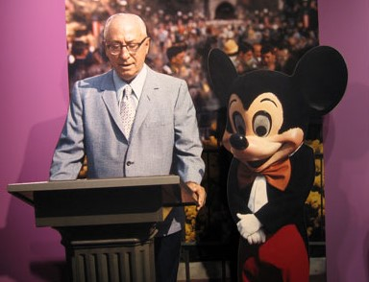
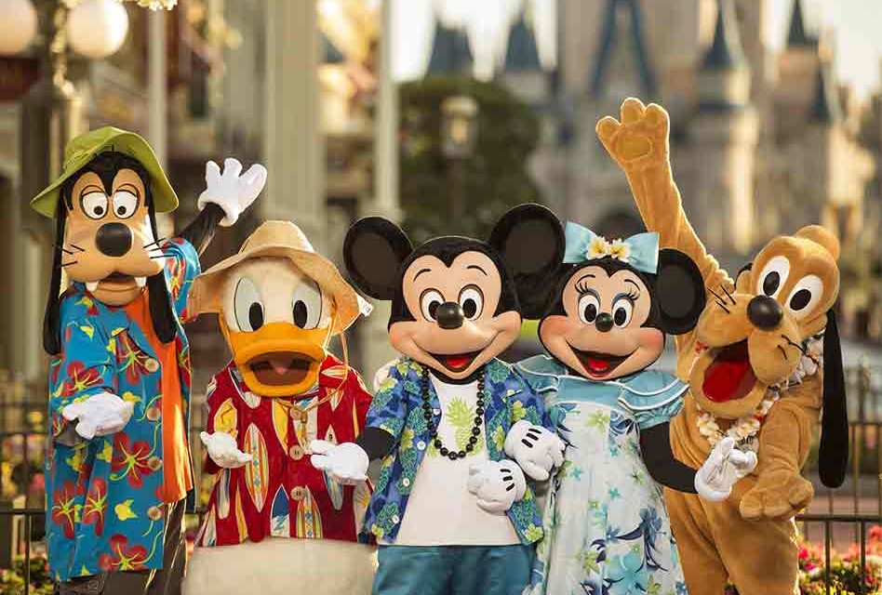
Leadership and Employee Training Programs
Professional Development Training Course
Employee Engagement Training
Cross-Training
Notes:
Hareem

Slide 12
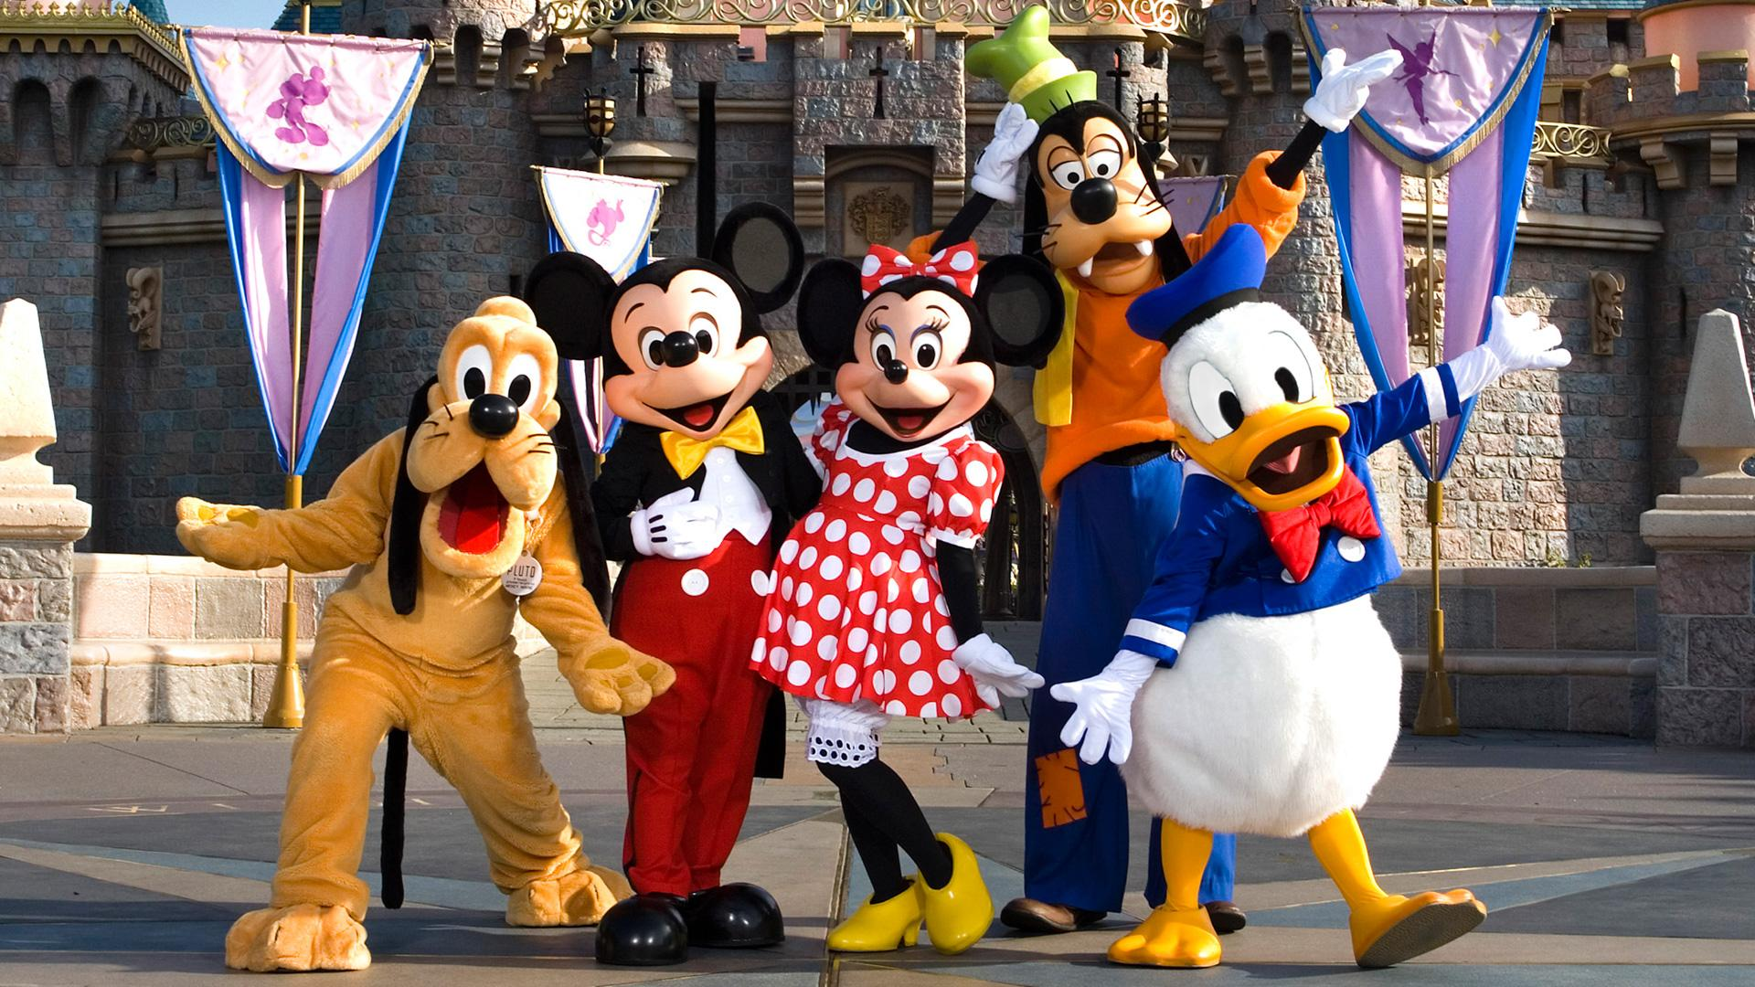
Professional Development Training Course
Employee-to-Employee care
Creating healthy relationships increases team effectiveness
Home-like environment in the workplace to achieve higher productivity
Disney’s Approach to Employee Engagement
It increases the overall productivity of the company.
Sufficient training ensures more opportunities and improve communication skills
Notes:
Hareem

Slide 13

Cross-Training
Cross training at disney is mandatory for all team members
Employees are appointed to different tasks everyday and are moved around the company to broaden their skills set and support their career growth.
Cross training at Disney sets them apart from other companies because there isn’t much employee interaction
Notes:
Hareem

Slide 14
Key advantages of Cross-training
It prevents Boredom
Job rotation happens frequently on every level, and in some cases, every hour.
Assigned to eight different roles, overlooking other cast members and guest experiences from every angle of the location.
Explore their options
Multiple opportunities to explore their options and find their passion.
Utilise their individual talents to improve the overall productivity and success of the company.
No competition between employees for positions.
Improve workplace Culture
Opportunity to learn and grow under different supervisors
Bring their previous insights to the next role
Encourages the growth of individual employees as well as the company as a whole.
Notes:
Hareem

Slide 15
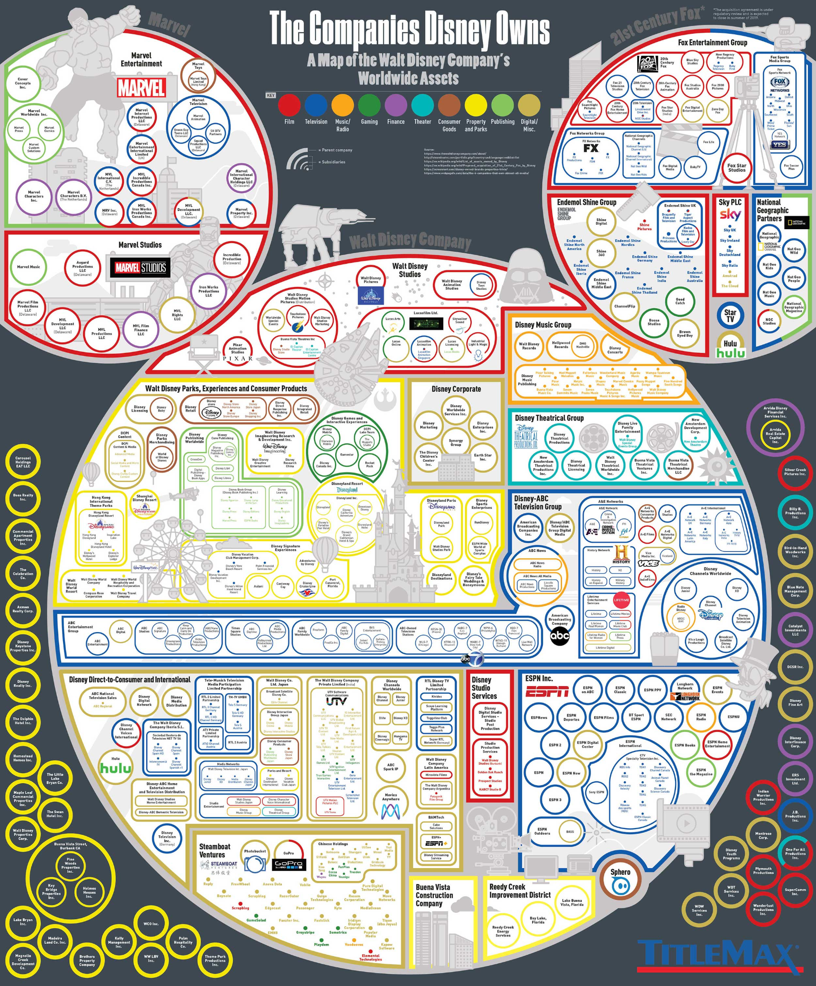
Disney Structure
Multidivisional (M-form) organizational structure
Business Type Segments
Parks & Resorts, Studio Entertainment, Consumer Products
Functional Groups Divisions
Finance, Communications, Legal
Geographic Divisions
North America, Europe, Asia Pacific, Latin America
Notes:
Steven

Slide 16
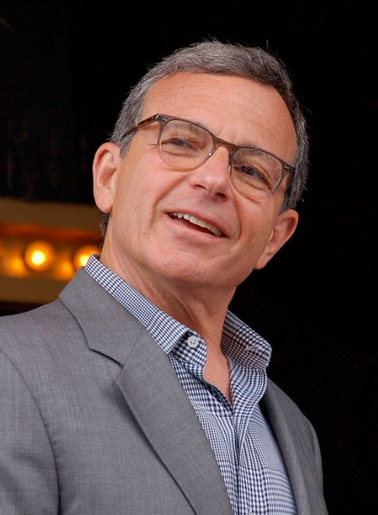
Bob Iger
CEO from 2005 to 2020
Acquired Pixar, Marvel, Lucasfilm, 21st Century Fox
Hong Kong and Shanghai Disneyland's
Disney +
3.3 Billion 2006 to 11 Billion 2019
Notes:
Steven

Slide 17
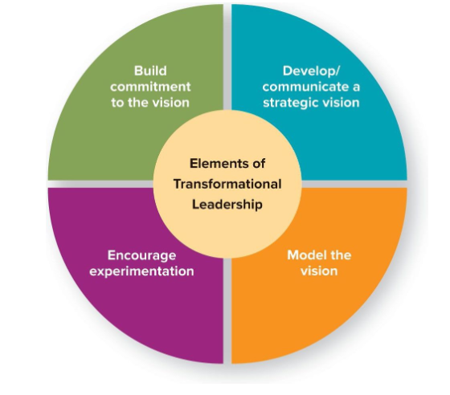
Leadership Qualities/Principles of Bob Iger
9 principles of leadership
Optimism.
Courage
Focus
Decisiveness
Curiosity
Fairness
Authenticity
The Relentless Pursuit of Perfection.
Integrity
(Iger, p.22-23) (Iger & MasterClass, 2021)
Notes:
Steven

Slide 18
References
Central Florida Theme Parks. (2018a, April 23). CAST MEMBERS [Photo]. https://www.positivelyosceola.com/disney-world-hirng-3500/
Central Florida Theme Parks. (2018b, April 23). Walt Disney [Photo]. Cast Members. https://www.google.com/url?sa=i&url=https%3A%2F%2Fwww.positivelyosceola.com%2Fdisney-world-hirng-3500%2F&psig=AOvVaw2ATa9nJLocBAWBOKJlNnqB&ust=1638085729607000&source=images&cd=vfe&ved=0CAsQjRxqFwoTCMCV_tbet_QCFQAAAAAdAAAAABAZ
Disney Attractions Cast Members. (2014, April 22). [Photo]. Doctor Disney. https://www.google.com/url?sa=i&url=http%3A%2F%2Fdoctordisney.com%2F2014%2F04%2F22%2F10-things-disney-attractions-disney-cast-members-dont-want-you-to-know%2F&psig=AOvVaw3Q1uKvj1NvVrOfUp6somR8&ust=1638087550303000&source=images&cd=vfe&ved=0CAsQjRxqFwoTCPjMuLnlt_QCFQAAAAAdAAAAABAD
Disney Institute Team. (2020, December 14). Training Course [Photo]. Disney Institute Blog. https://www.google.com/url?sa=i&url=https%3A%2F%2Fwww.disneyinstitute.com%2Fblog%2Fnew-year-new-skills-reach-your-2021-professional-goals-with-courses-from-49%2F&psig=AOvVaw3jbn5qPr2MiBvjQAfaH_nR&ust=1638087331914000&source=images&cd=vfe&ved=0CAsQjRxqFwoTCLC3iNHkt_QCFQAAAAAdAAAAABAD
Harris, W. (2020, January 27). Why is it Called a Phillips Screwdriver? Handyman Guides. https://handymanguides.com/tips/phillips-screwdriver-history/

Slide 19
Leibacher, H. (2020, March 5). DISNEY CEOS THROUGH THE YEARS [Photo]. World of Walt. https://www.google.com/url?sa=i&url=https%3A%2F%2Fwww.worldofwalt.com%2Fa-legacy-of-leaders-disney-ceos-through-the-years.html&psig=AOvVaw1oumsHPGUPJcultrhBZGX_&ust=1638085525970000&source=images&cd=vfe&ved=0CAsQjRxqFwoTCIi2uPjdt_QCFQAAAAAdAAAAABAJ
Olya, G. (2020, September 29). Disneyland employee [Photo]. The Secret Life of a Disneyland Employee. https://www.google.com/url?sa=i&url=https%3A%2F%2Fwww.gobankingrates.com%2Fmoney%2Fjobs%2Fsecrets-of-disneyland-employees%2F&psig=AOvVaw3SBk7vc2qVi3ytw_ePZYSQ&ust=1638083130822000&source=images&cd=vfe&ved=0CAsQjRxqFwoTCPDFlYLVt_QCFQAAAAAdAAAAABAD
Popick, J. (2015, November 6). Cross-Training [Photo]. Team Building. https://www.google.com/url?sa=i&url=https%3A%2F%2Fwww.inc.com%2Fjanine-popick%2F5-critical-reasons-to-cross-train-your-employees.html&psig=AOvVaw07HimEGOimJTvKyVVdcqNS&ust=1638086728616000&source=images&cd=vfe&ved=0CAsQjRxqFwoTCKCv8cjit_QCFQAAAAAdAAAAABAD
Rothbaum, N. (2017, October 5). Going 10 Rounds With Top Bartender Joaquín Simó. The Daily Beast. https://www.thedailybeast.com/going-10-rounds-with-top-bartender-joaquin-simo
Screwdriver (cocktail). (2021, November 10). Wikipedia. https://en.wikipedia.org/wiki/Screwdriver_(cocktail)
To Call or to be Called, That is the Question. (n.d.). Callcentrejob.ca. Retrieved November 30, 2021, from https://www.callcentrejob.ca/tools-and-resources/professional-development-and-training-in-a-call-center/

Slide 20

Goodbye!

